Slide 1
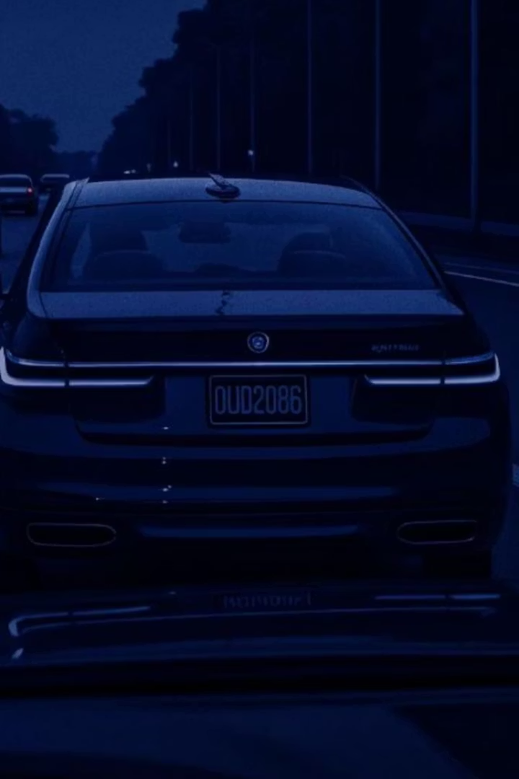
License Plate Detection System
Computer vision system to detect license plates from dashcam videos.
Dominique McBride
Regis University, Practicum II

Slide 2
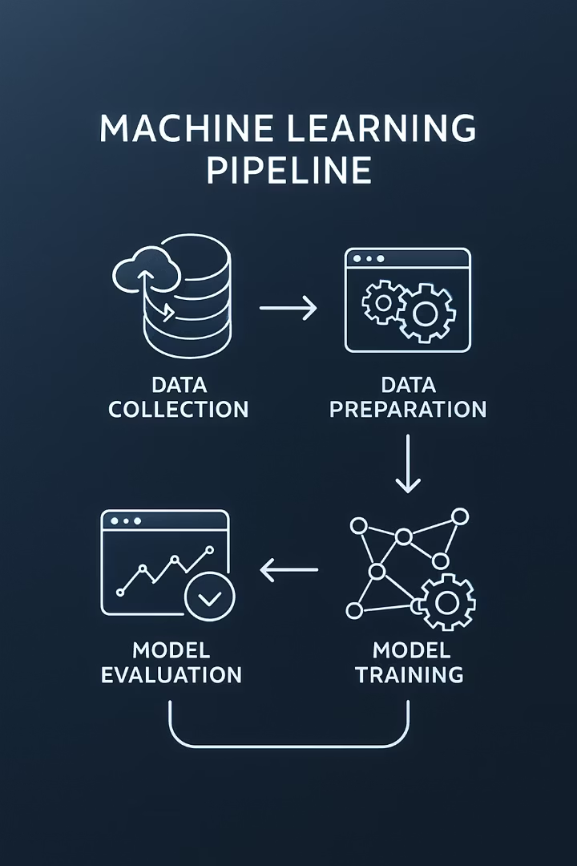
Project Scope
Extract Frames
Create Dataset
Process video into individual frames
Record video in different driving scenarios
Train Model
Annotate Images
Develop and optimize YOLO detection model
Label license plates in extracted frames

Slide 3
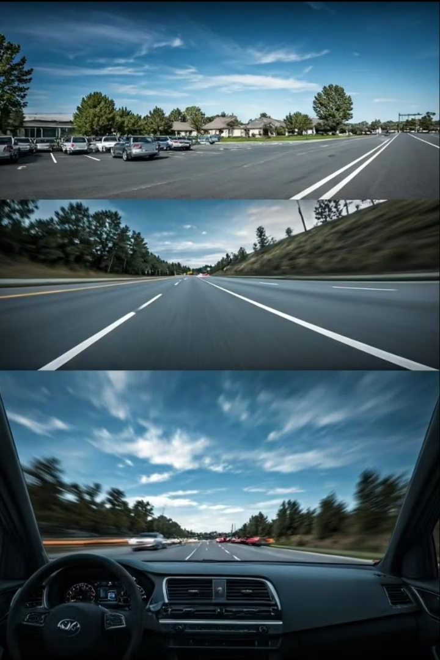
Data Collection Scenarios
Scenario
Details
Parking Lot
Stationary vehicles, clear plates
Neighborhood
Slow traffic, stop signs
Intersections
Vehicles in close proximity
Rush Hour Highway
Dense traffic patterns
High-Speed (70mph)
Motion blur challenges

Slide 4
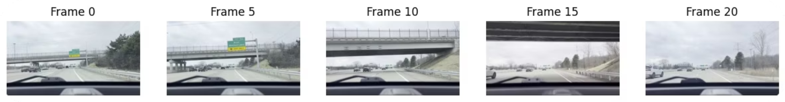
Frame Extraction
29.99
21,630
FPS
Total Frames
Frames per second in source video
Complete video frame count
12:16
2,163
Duration
Extracted
Video length in minutes
Every 10th frame selected

Slide 5
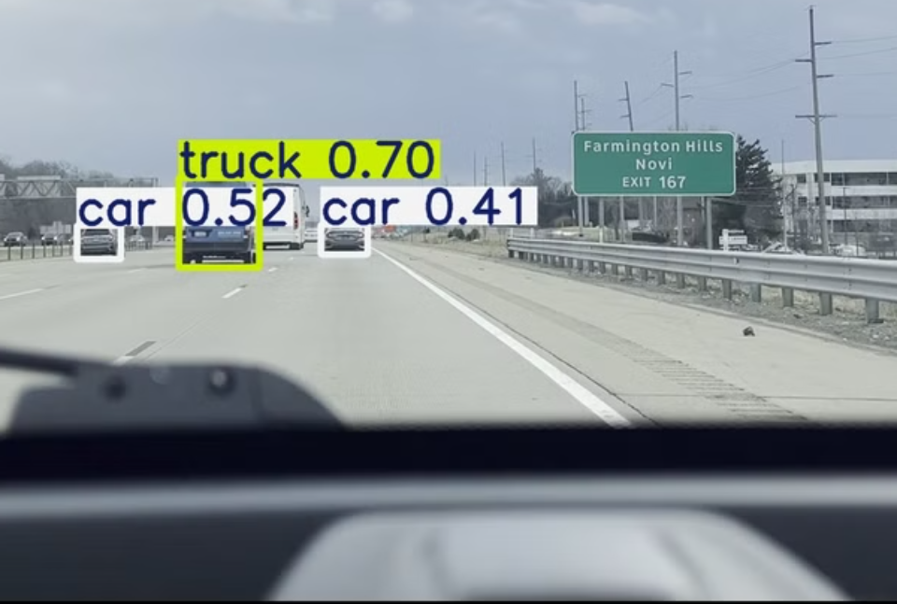
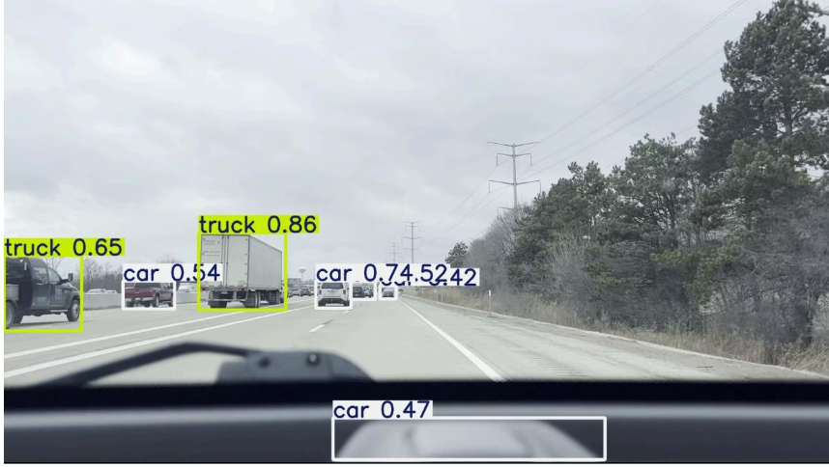
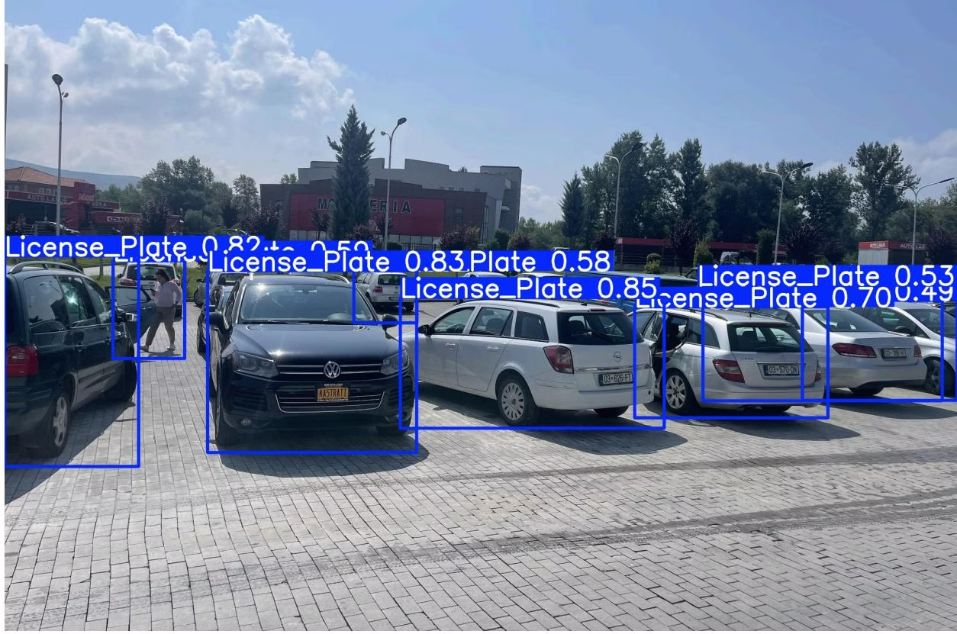
Automated Labeling Challenges
Initial Approach
The standard YOLO model does not include a specific class for license plates, resulting in unsuccessful automated labeling. In some cases, the model even misclassified dashboard elements as objects of interest.
Example of unsuccessful automated labeling attempt

Slide 6
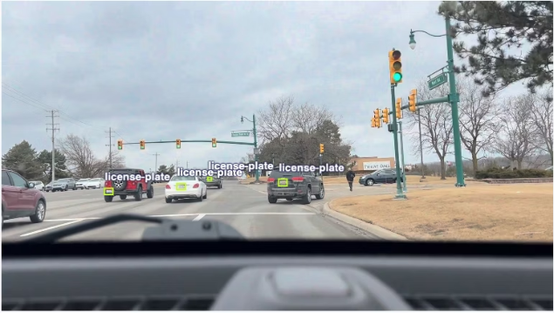
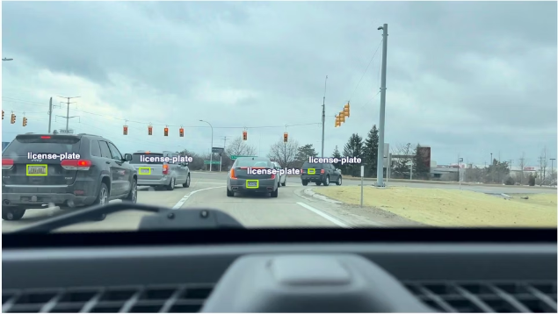
Manual Annotation Process
Bounding Box Creation
Tool Selection
Manually drew bounding boxes around each visible license plate across all 2,163 images
Chose Roboflow labeling tool for its intuitive interface and compatibility with YOLO format
Quality Control
Multiple Object Handling
Removed poor quality or ambiguous images to develop a clean, high-quality dataset
Labeled all visible license plates in each frame, with some images containing multiple plates

Slide 7
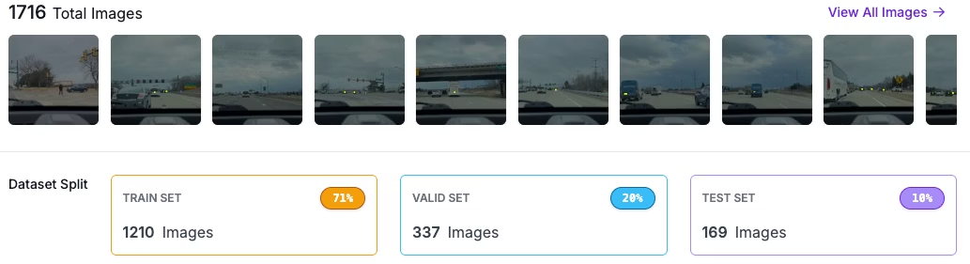

Model Training and Comparison
YOLOv8 Variants
Performance Metrics
YOLOv11 Comparison
Training Efficiency
Tested multiple YOLOv8 model sizes including nano (n), small (s), and medium (m) configurations to determine optimal performance balance
Analyzed precision, recall, and mAP scores across models to identify the best performer for license plate detection
Evaluated newer YOLOv11 nano and medium models against YOLOv8 to assess potential improvements in detection accuracy
Considered training time and computational requirements alongside detection performance

Slide 8
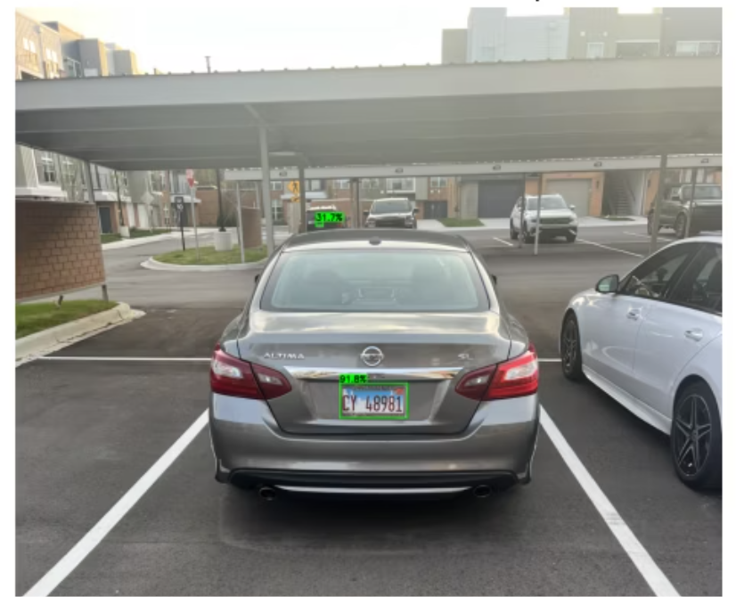
Detection Performance by Distance
At 5ft away, this model was able to successfully identify a license plate with a confidence score of 91%.
Confidence Threshold
Appropriate confidence threshold were applied to balance between detecting all license plates and minimizing false positives.
83%
Precision Rate
72%
Recall

Slide 9
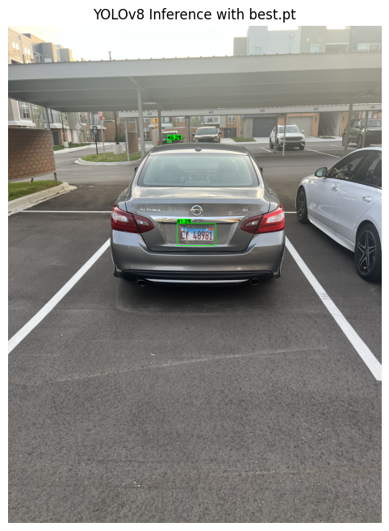
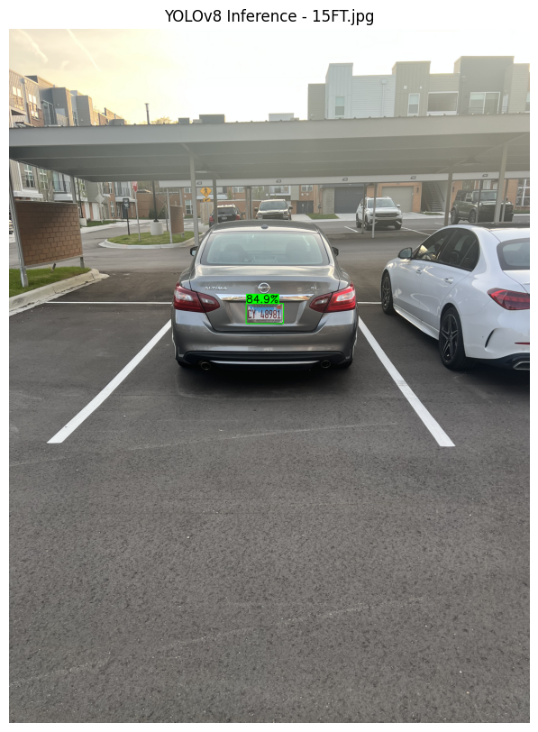
Close Range Performance (10-15ft)
Ideal for parking enforcement, drive-through security
10 Feet (61%)
15 Feet (84%)
Exceptional detection, very high confidence
Strong performance, slight confidence decrease

Slide 10
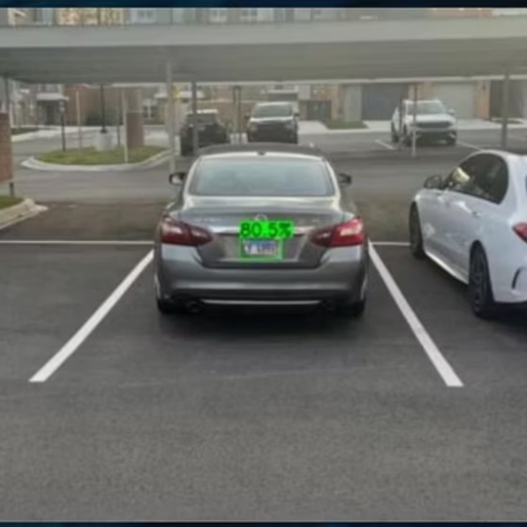
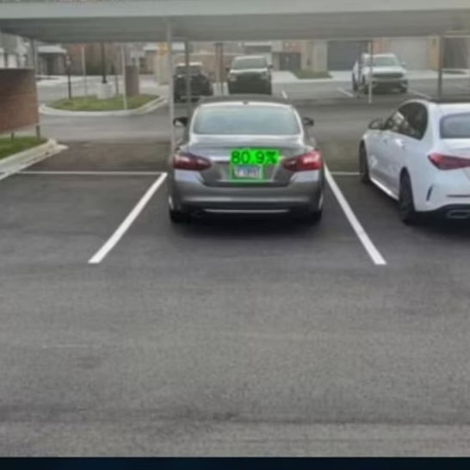
Mid Range Performance (20-25ft)
Crucial for typical driving scenarios, urban environments
20ft: Good confidence, clear identification
25ft: Noticeable confidence decrease, still accurate

Slide 11
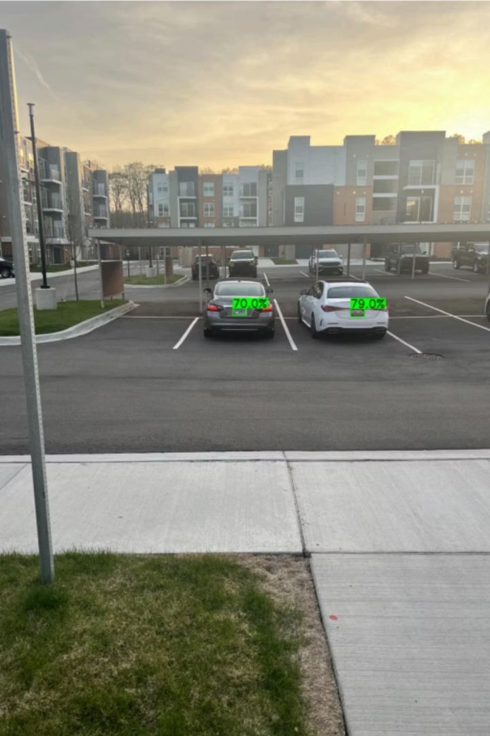


Long Range Performance (30ft+)
30 Feet Detection
Beyond 30 Feet
Lower confidence but functional detection
Operational limit, significantly reduced reliability

Slide 12




Distance Performance Analysis
Medium Range (20-25ft)
Close Range (10-15ft)
1
2
Good performance with slightly reduced confidence as distance increases
Excellent detection with high confidence scores at close distances
Motion Factors
Long Range (30ft+)
4
3
Performance affected by motion blur at higher speeds and distances
Detection capability diminishes at extended distances
The YOLOv8 model performs optimally at distances under 25 feet

Slide 13
Summary and Next Steps
Custom Dataset
Future Work
Created and manually labeled 2,163 frames.
Expand dataset with more image types
Model Training
Improve detection at longer distances and motion blur
Incorporate OCR to read plates
Compared YOLOv8 and YOLOv11 models.
Evaluate performance on Yolov8L
Detection Performance
Effective detection up to 25 feet; challenges beyond.

